Slide 1

NoSQL Database
“Towards the end of RDBMS ?”
Habiba Ahmed Magdy habiba.hamad97@eng-st.cu.edu.eg

Slide 2
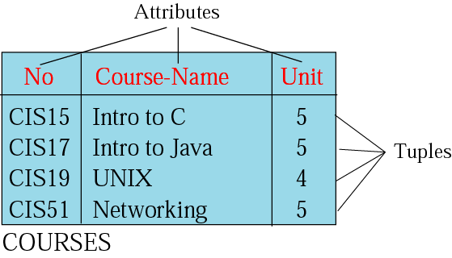
What is RDBMS
RDBMS: the relational database management system.
Standard Query language (SQL) Database
Relation: a relation is a 2D table
Notes:
Relational Database Management Systems (RDBMS) have existed for a few decades now.
Relational databases are also known as "SQL databases"
store data through a standard data modeling and query language (Structured Query Language, or SQL).
In SQL databases, business entities are represented by logical, tabular format data structures called "tables".
For example, a database table can represent the data elements for sales transactions, another table can represent employee personal information while another table can represent product inventory. Tables are made up of columns of specific data type and lengths. Each column (or field) represents an attribute of the entity. For example, a table hosting employee information can have fields like first_name, last_name, age or start_date.

Slide 3
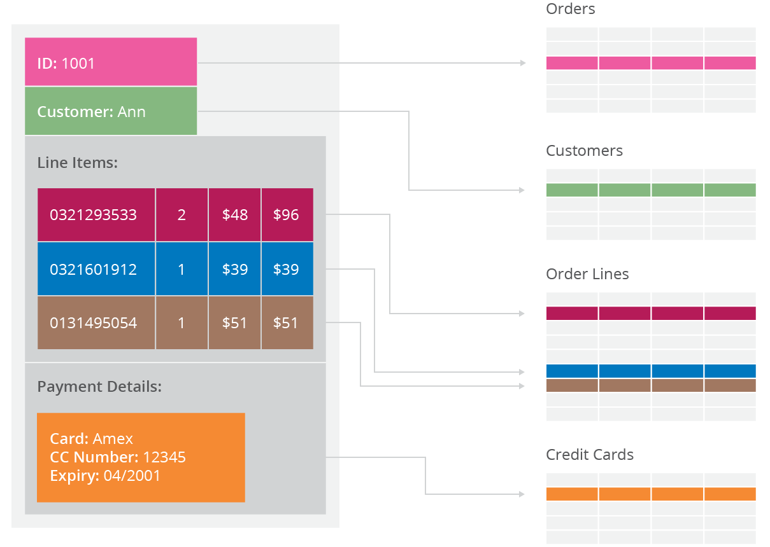
Issues with RDBMS
The Need for NoSQL
Scaling up when the dataset is just too big e.g. Big Data.
Not designed to be distributed.
Predefined Schema
Expensive
Different approaches
Notes:
Since the rise of the web, the volume of data stored about users, objects, products and events has exploded. Data is also accessed more frequently, and is processed more intensively – for example, social networks create hundreds of millions of customized, real-time activity feeds for users based on their connections' activities.
Even rendering a single web page or answering a single API request may take tens or hundreds of database requests as applications process increasingly complex information.
Relational databases were never designed to cope with the scale and agility challenges that face modern applications – and aren't built to take advantage of cheap storage and processing power that's available today through the cloud. Relational database vendors have developed two main technical approaches to address these shortcomings: Cloud
Relational databases require that schemas be defined before you can add data. For example, you might want to store data about your customers such as phone numbers, first and last name, address, city and state – a SQL database needs to know this in advance.
This fits poorly with agile development approaches, because each time you complete new features, the schema of your database often needs to change. So if you decide, a few iterations into development, that you'd like to store customers' favorite items in addition to their addresses and phone numbers, you'll need to add that column to the database, and then migrate the entire database to the new schema.
If the database is large, this is a very slow process that involves significant downtime. If you are frequently changing the data your application stores – because you are iterating rapidly – this downtime may also be frequent. There's also no way, using a relational database, to effectively address data that's completely unstructured or unknown in advance.

Slide 4

What is NoSQL
Stands for Not Only SQL.
Non-relational data storage systems.
Recognized for their ease of development, functionality, and performance at scale.
Use a variety of data models
Notes:
so one common misconception with no SQL is people some people think that it actually stands for no SQL like it's not possible when really it stands for not only SQL because it is quite possible to use SQL on some of these databases it's not you know it's not extremely common but it is possible so in my opinion I think a better word to describe it is a non relational database alright
The solution is to scale horizontally, by adding servers instead of concentrating more capacity in a single server. Cloud computing makes this significantly easier, with providers such as Amazon Web Services providing virtually unlimited capacity on demand, and taking care of all the necessary database administration tasks. Developers no longer need to construct complex, expensive platforms to support their applications, and can concentrate on writing application code. In addition, a group of commodity servers can provide the same processing and storage capabilities as a single high-end server for a fraction of the price.

Slide 5
NoSQL Database Features
Flexible schemas for building modern applications.
Does not depend on predefined tables.
Flexibility in Data Storage: host semi-structured or unstructured data.
Designed to be distributed, Horizontal scaling.
The concept of joining records from multiple tables doesn’t exist (Later)
Notes:
Does not depend on predefined tables. A table can be created, and records added to it dynamically

Slide 6
What Drives The Need of NoSQL
Explosion of social media sites (Facebook, Twitter, Google etc.) with large data needs.
Rise of cloud-based solutions, simple storage solution.
Moving to dynamically-typed data with frequent schema changes.
Expansion of Open-source community.
Support automatic replication: high availability and disaster recovery without involving separate applications to manage these tasks
Notes:
Cloud computing makes this significantly easier, with providers such as Amazon Web Services providing virtually unlimited capacity on demand, and taking care of all the necessary database administration tasks. Developers no longer need to construct complex, expensive platforms to support their applications, and can concentrate on writing application code. In addition, a group of commodity servers can provide the same processing and storage capabilities as a single high-end server for a fraction of the price.
"Sharding" a database across many server instances can be achieved with SQL databases, but usually is accomplished through SANs and other complex arrangements for making hardware act as a single server. NoSQL databases, on the other hand, usually support auto-sharding, meaning that they natively and automatically spread data across an arbitrary number of servers, without requiring the application to even be aware of the composition of the server pool.
Most NoSQL databases also support automatic replication, meaning that you get high availability and disaster recovery without involving separate applications to manage these tasks. The storage environment is essentially virtualized from the developer's perspective.

Slide 7
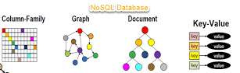
NoSQL Data Model Types
NoSQL database are classified into four types:
Key Value pair based
Column based
Document based
Graph based

Slide 8
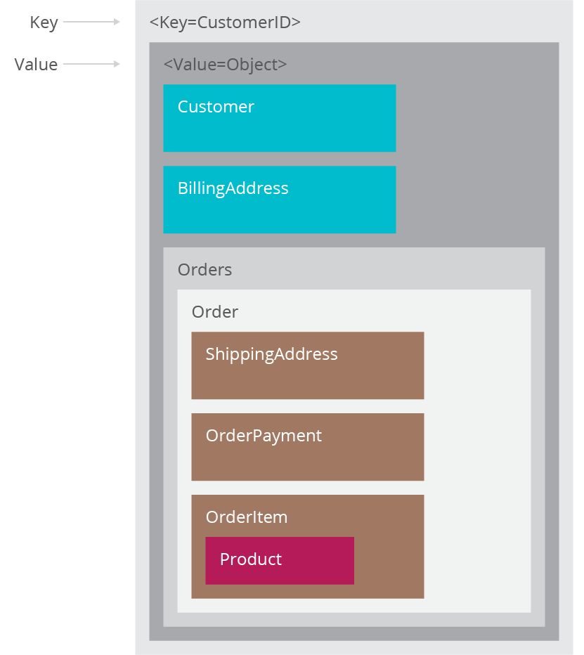
Key Value Pair Based
Simplest NOSQL databases where it use a hash table to access data (values) by strings called keys
Data has no required format data may have any format
Use it: storing session info. , user profiles, shopping cart data.
Avoid it: need to query data having relationships between entities.
Examples :Amazon DynamoDB, Oracle NoSQL Database, Redis, etc.
Notes:
The key is a pointer to the value; the value can be an image, a JSON document or even a single text string or number.
Records are stored and retrieved using a key(Fast Search) that uniquely identifies the record, and is used to quickly find the data within the database.

Slide 9
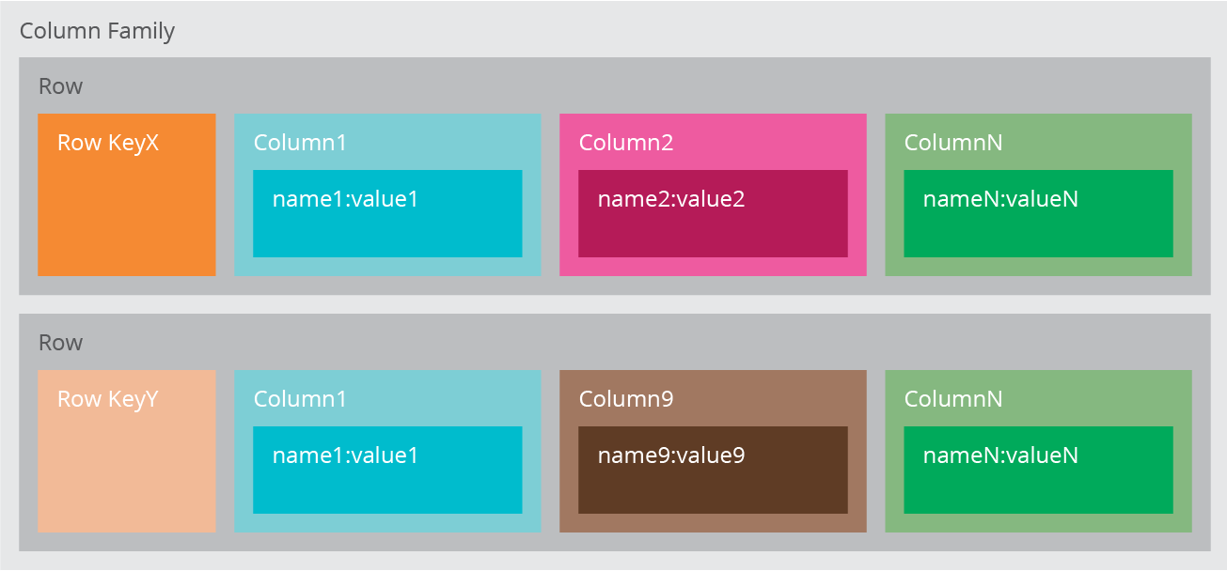
Column based
It store data as Column families containing rows that have many columns associated with a row key. Each row can have different columns.
Column families are groups of related data that is accessed together.
We use it for content management systems(WordPress), blogging, etc.
We would avoid it for systems that are in early development, changing query patterns.
Example: Cassandra, HBas and Hypertable.
Notes:
Column oriented databases are the opposite of row-based relational databases.
Content management is a set of processes and technologies that supports the collection, managing, and publishing of information in any form or medium.

Slide 10
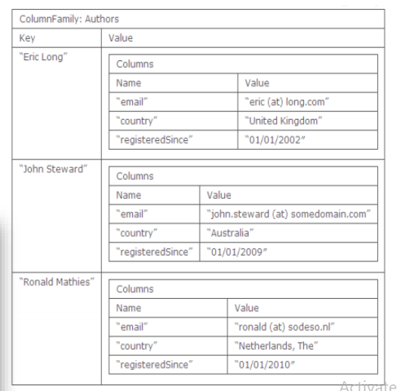

Slide 11
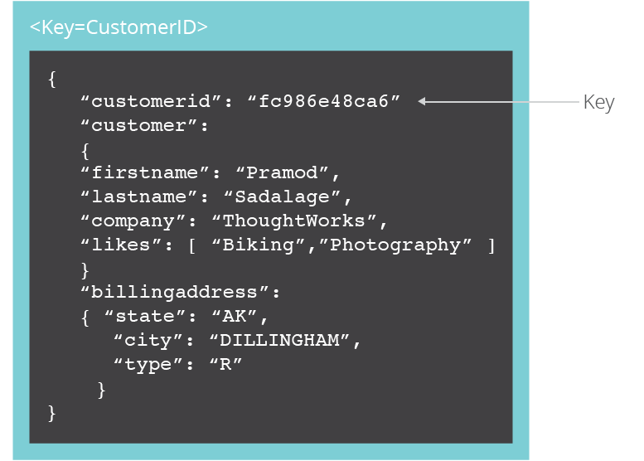
Document Based
The database stores and retrieves documents (JSON documents).
It stores documents in the value part of the key-value store.
We use it for content management systems, blogging platforms, web analytics, real-time analytics.
Examples: MongoDB, Couchbase, Orient DB, Raven DB.
We would avoid it for systems that need complex transactions spanning multiple operations or queries against varying aggregate structures.
Notes:
Used to store JSON (Java Script Object Notation) documents. These JSON documents can have different schemas and elements within them, but the same table can be used to host all data.
News organizations, e-commerce websites, and educational institutions

Slide 12
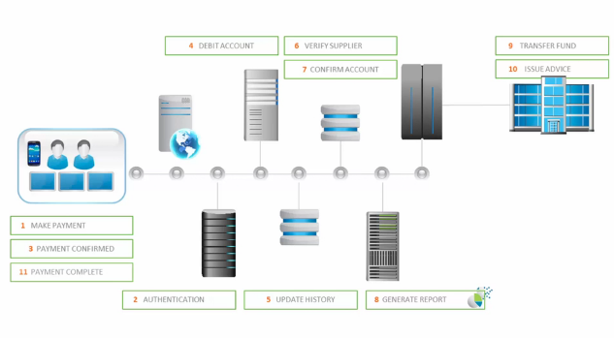
Complex transactions spanning multiple operations

Slide 13
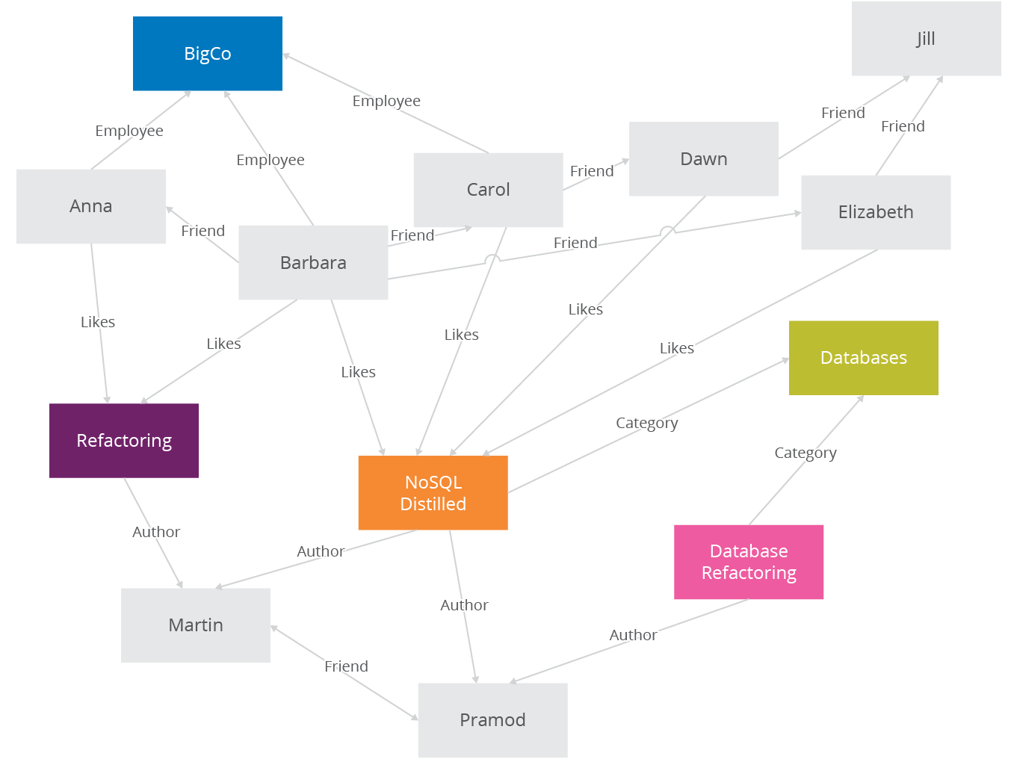
Graph Based
Use components like "edges", "nodes", and "properties" to store and relate data.
Traversing the relationships is very fast.
It is well suited for connected data, such as social networks, and e-commerce stores.
Example: Neo4J, Infinite Graph, FlockDB.
Neptune are examples of graph databases.
Notes:
Graph databases are different from other types of NoSQL databases because they do not represent data in rows, columns, tables or column families. Instead, graph databases use components like "edges", "nodes", and "properties" to store and relate data.
The nodes are like entities in a relational database and will have some properties. The relationship between two nodes can have properties too.
A typical use case of graph database is recommendations in e-commerce stores.
Neo4j or AWS Neptune are examples of graph databases.

Slide 14
CAP Theorem
A distributed system has 3 properties :
Consistency (Write & Return)
Availability (Response)
Partitions-Tolerant
We can have at most two of these three properties for any shared-data system
To scale out, we have to partition. It leaves a choice between consistency and availability. ( In almost all cases, we would choose availability over consistency)
Everyone who builds big applications builds them on CAP : Google, Yahoo, Facebook, Amazon, eBay, etc.
Notes:
Distributed system is a system made up of multiple machines and nodes communicating with one another over a network
consistency: is when I write to one node when I read from another I get what I wrote ( second node will return smthn no older than what I had just wrote)
Availability: is promise when I talk to one node it will respond unless node has failed
Partitions: A system that is partition-tolerant can sustain any amount of network failure that doesn’t result in a failure of the entire network.
Data records are sufficiently replicated across combinations of nodes and networks to keep the system up through intermittent outages. When dealing with modern distributed systems, Partition Tolerance is not an option. It’s a necessity. Hence, we have to trade between Consistency and Availability.

Slide 15
Cassandra Vs MongoDB Vs Redis
 | Cassandra | MongoDB | Redis
Data Model | Column-Family structure | JSON document format | Key Value Pair Based
Known for | leading NoSql distributed data management system | flexible & schema-less database | Redis works with an in-memory dataset
Written in | Java | C++ | ANSI C.
Notes:
In-memory: run in memory

Slide 16
Cassandra Vs MongoDB Vs Redis
Cassandra | MongoDB | Redis
Failure handling Best-in-class scalability and performance | High flexibility scale and performance Deploy Big apps applications | Exceptionally Fast. Easily insert huge amounts of data. Operations are atomic
Availability & Partition Tolerance | Consistency and Partition Tolerance | Consistency and Partition Tolerance
SoundCloud - Netflix - Apple | eBay - Adobe- Google - Facebook | Twitter - GitHub - Snapchat
Notes:
In cassandra every node contains a replica and in case of failure the replica takes charge so there is no chance of failure and it ensures 100% availability it also offers lowest total cost of ownership
Cassandra it has a decent less architecture and any node can perform any operation in this case it providesap from the cap theorem that is it provides availability and partition tolerance from the cap theorem and
MongoDB lets innovators deploy apps as big as they can possibly dream from startups to enterprises for giant ideas
Redis is very fast and can perform about 110000 SETs per second, about 81000 GETs per second.
Redis allows inserting huge amounts of data into its cache very easily. Sometimes, it is required to load millions of pieces of data into the cache within a short period of time. This can be done easily using mass insertion, a feature supported by Redis.
Operations are atomic : All the Redis operations are atomic, which ensures that if two clients concurrently access Redis server will get the updated value.

Slide 17
What is not provided by NoSQL
Joins & Group by [SQL]
Integration with applications that are based on SQL
Notes:
roup by is used to group different row of data together based on any one column.
SQL query for the above requirement will be,
SELECT name, age
FROM Emp GROUP BY salary
A JOIN clause is used to combine rows from two or more tables, based on a related column between them.
INNER JOIN Customers ON Orders.CustomerID=Customers.CustomerID;

Slide 18
Where to use NoSQL
NoSQL Data storage systems makes sense for applications that process very large semi-structured data –like Log Analysis, Social Networking Feeds, Time-based data.
To improve programmer productivity by using a database that better matches an application's needs.
To improve data access performance via some combination of handling larger data volumes, reducing latency, and improving throughput.
Notes:
latency = wqt al astgaba

Slide 19
Conclusion
All the choices provided by the rise of NoSQL databases does not mean the demise of RDBMS databases as Relational databases are a powerful tool.
We are entering an era of Polyglot persistence, a technique that uses different data storage technologies to handle varying data storage needs. It can apply across an
enterprise or within an individual application.

Slide 20
References
https://www.youtube.com/watch?v=uD3p_rZPBUQ
https://www.slideshare.net/ramakantsoni/presentation-on-no-sql
https://www.mongodb.com/nosql-inline
https://www.mssqltips.com/sqlservertip/5980/sql-and-nosql-database-features-and-differences/
https://aws.amazon.com/nosql/
https://www.youtube.com/watch?v=Jw1iFr4v58M
https://www.youtube.com/watch?v=QlqylUeqeis&t=2s

Slide 21
Thank You
Habiba Ahmed Magdy habiba.hamad97@eng-st.cu.edu.eg

